Slide 1






A 24 hour AI Hackathon

Slide 2
Team Details
Team Name: HACKTASTIC FOUR
Team Members:
MITHIL SM
PEDDIREDDY SUNIL KUMAR
ROHITH B
JAYASHREE M REDDY

Slide 3
Problem Statement
Al for Predicting and Mitigating Disease Outbreaks in Vulnerable Populations
Global pandemics and regional disease outbreaks often disproportionately affect vulnerable populations due to delayed response and lack of predictive measures. Develop an Al system to predict potential disease outbreaks. The system should aim to decrease the spread of infectious diseases and support the development of resilient communities.
SDGs addressed:
1. SDG 3: Good Health and Well-Being
2. SDG 11: Sustainable Cities and Communities

Slide 4
Solution Overview
HEALTH GUARD employs an AI-driven framework that integrates various data sources to enhance outbreak prediction and prevention. The core components include:
Data Integration and Preprocessing: Collecting multi-modal data from healthcare records, environmental factors, and social media to identify disease patterns.
Machine Learning Models:
Time Series Analysis for historical trend identification.
Social Network Analysis to map transmission pathways.
Early Warning Systems:
Real-time monitoring for outbreak detection.
Automated alerts for swift response.
Community Empowerment:
Involving local communities in data collection and response efforts.
Capacity-building initiatives to enhance local outbreak management capabilities.
Ethical AI Use:
Safeguarding data privacy.
Ensuring fairness and accountability in AI decision-making.

Slide 5
Scalability
The scalability of the solution is emphasized through:
Adaptability to Data Sources: The use of diverse and dynamic data inputs allows the model to be applied in various regions and scenarios.
Community Engagement: Building local capacities ensures that the system can be tailored to specific community needs and sustained long-term.
Real-Time Systems: Continuous monitoring and automated alerts make it flexible for both small-scale and widespread implementation.

Slide 6
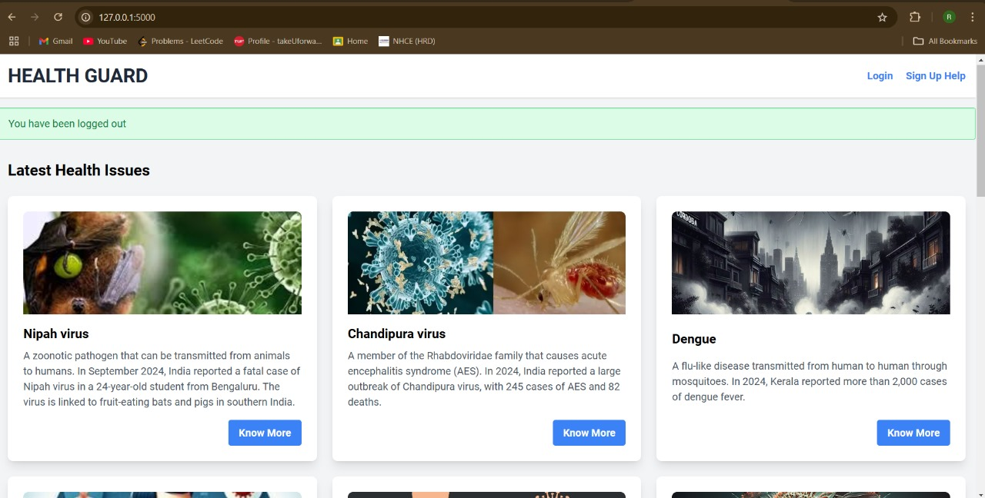
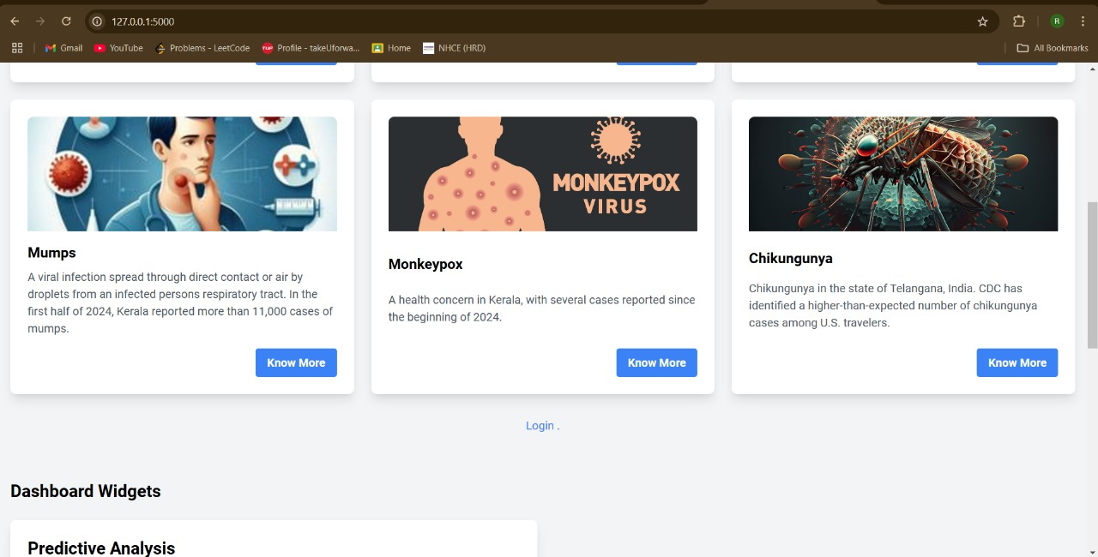
Interface

Slide 7
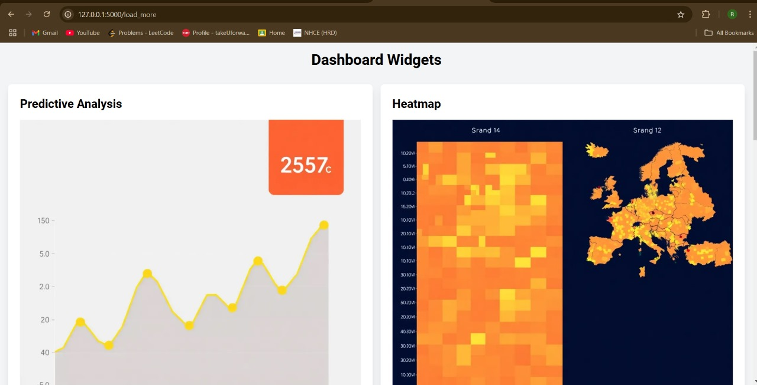
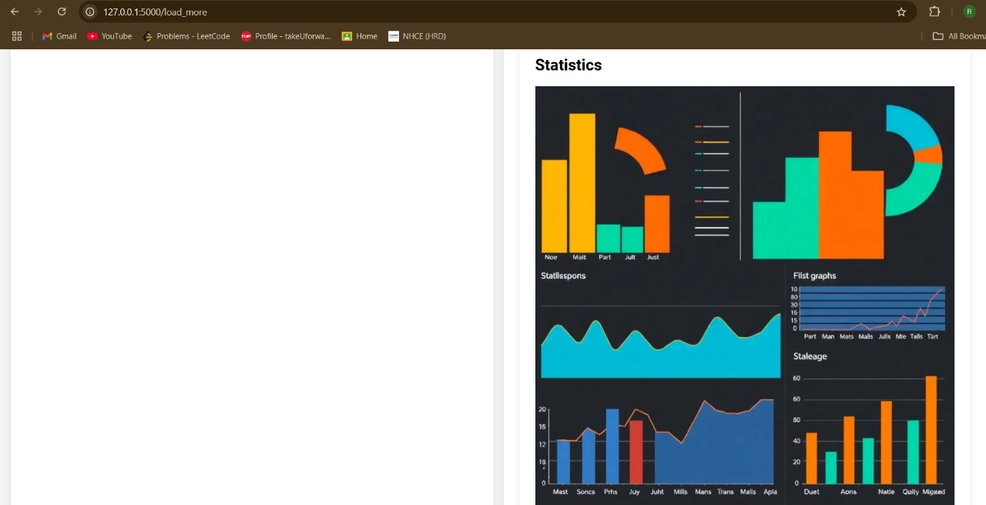
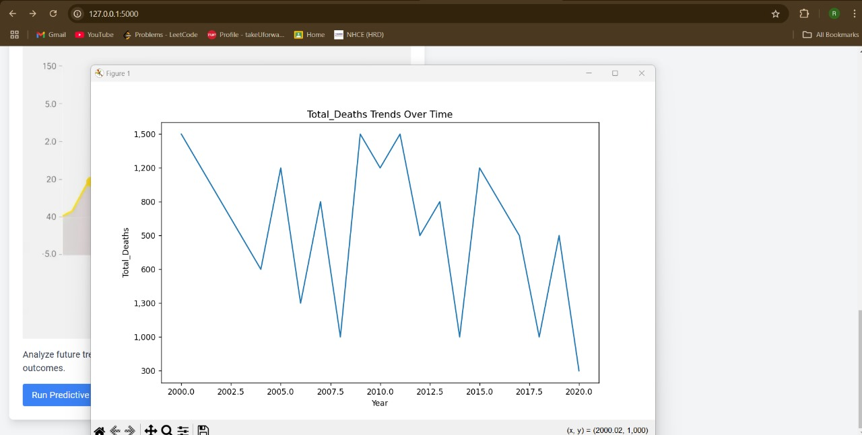
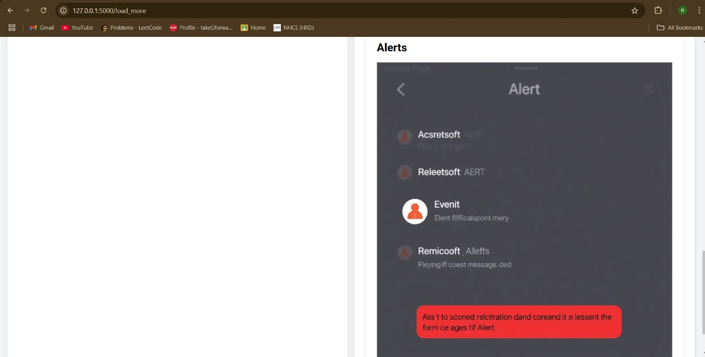

Slide 8
Conclusion
The HEALTH GUARD framework underscores the importance of proactive measures in healthcare. By leveraging AI and predictive analytics, it aims to mitigate the impact of disease outbreaks, promote equity, and strengthen community resilience. Ethical implementation and targeted interventions ensure that the solution remains inclusive and effective.

